Slide 1

Microsoft Teamwork Transformation
How Microsoft Teams and SharePoint power teamwork transformation.
<<Microsoft Partner Contact Information>>
Partner
Logo
Notes:
Title slide.

Slide 2

Agenda
Introduction
Assessment
Strategy
Execution
Support

Slide 3



better together

Slide 4

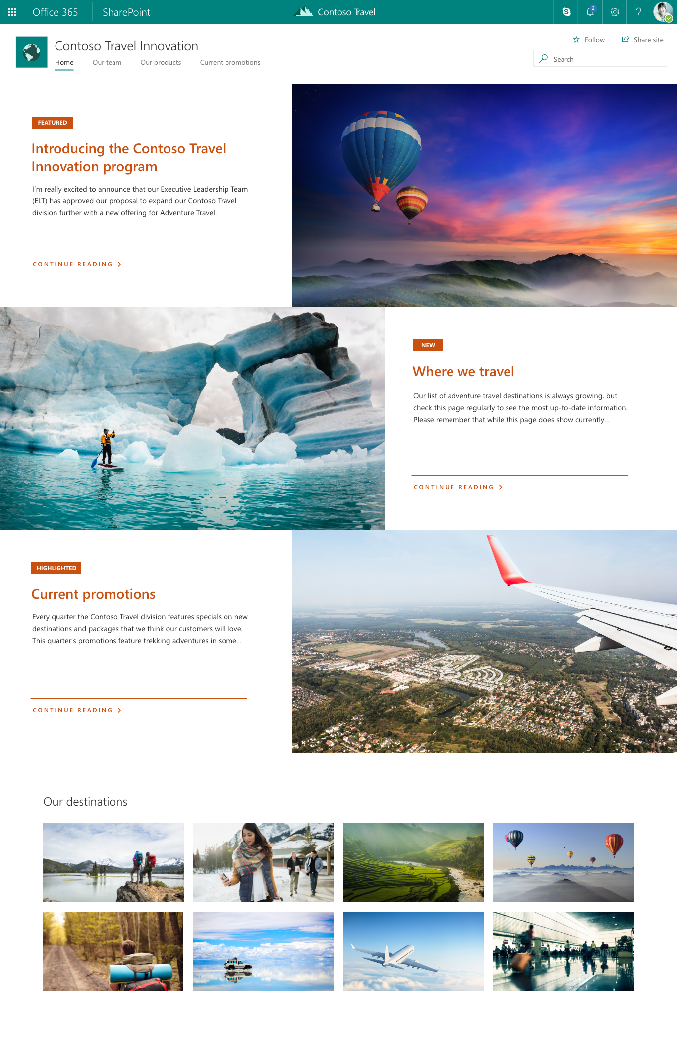
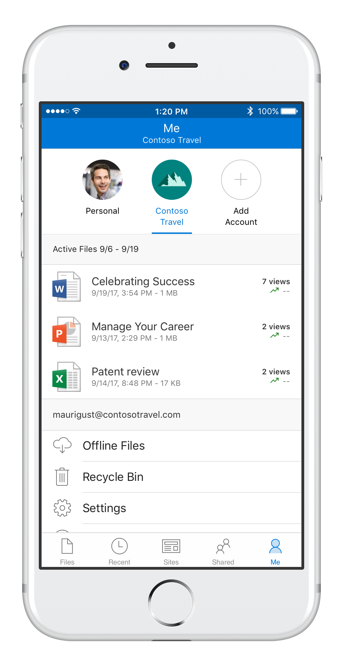
SharePoint Content collaboration for the modern workplace
Content services
shared files, pages, data, and apps across Office 365
Anywhere access to files
simple and secure sharing with OneDrive
Intelligent intranet & search
connect people, news, knowledge, and apps
Modern solutions framework
no-code apps, workflow, and custom development

Slide 5
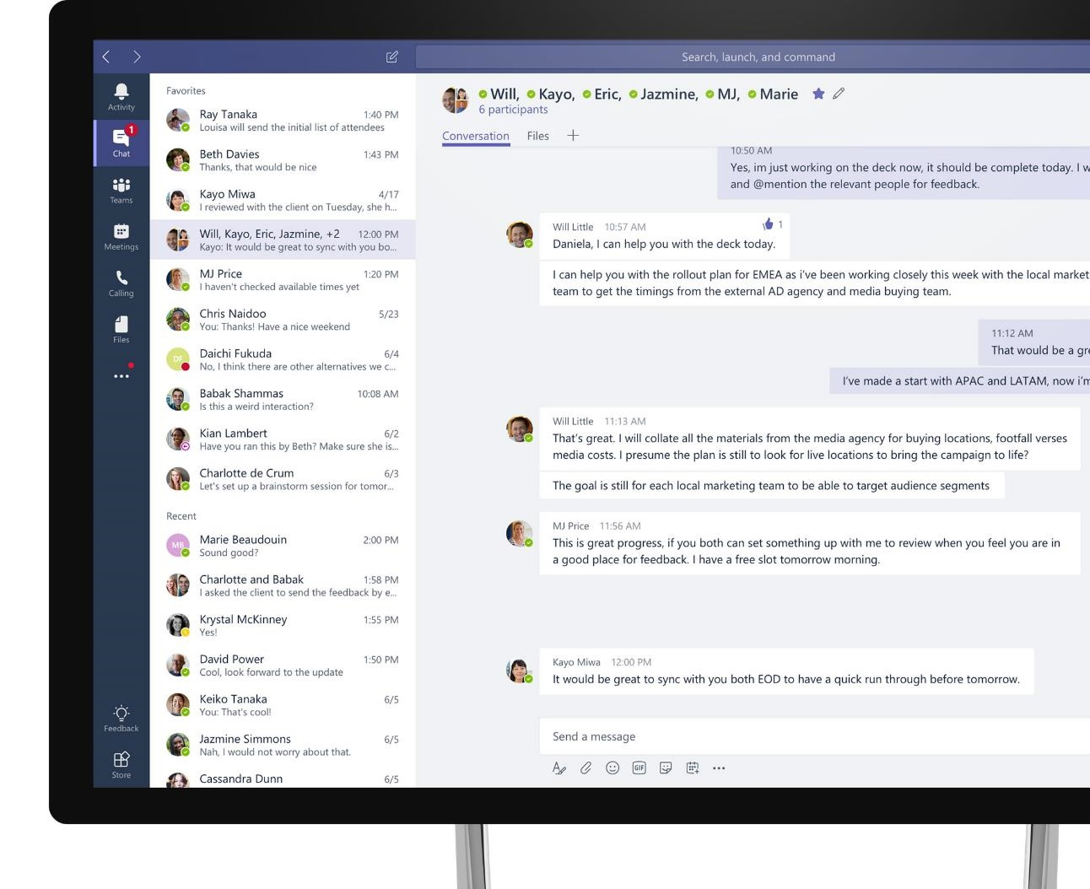
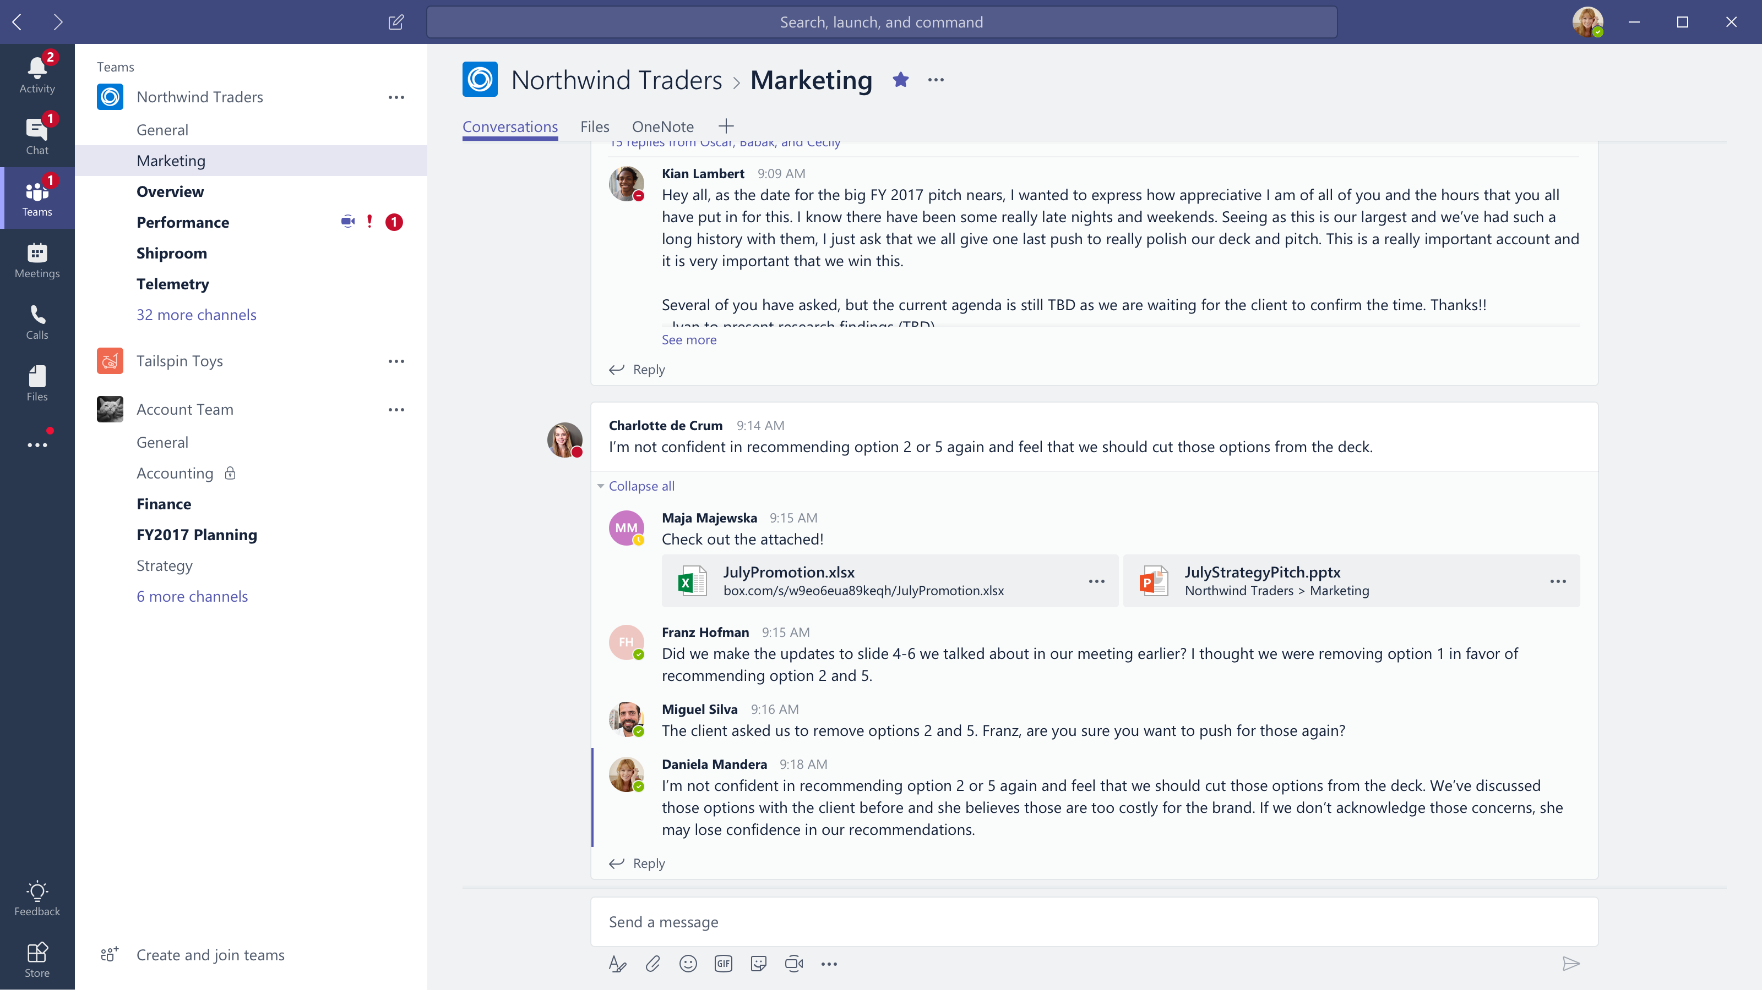








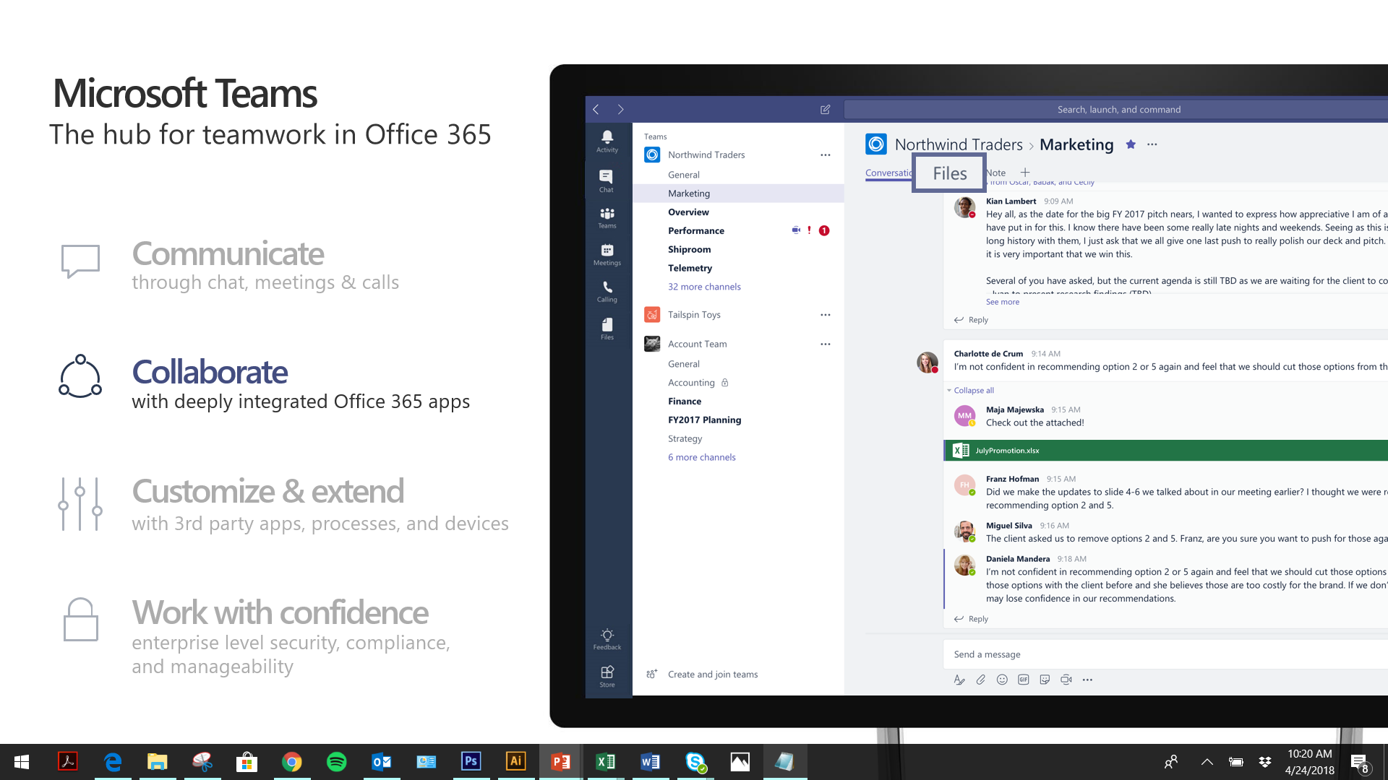



Microsoft Teams
The hub for teamwork in Office 365
Communicate
through chat, meetings & calls
Collaborate
with deeply integrated Office 365 apps
Customize & extend
with third-party apps, processes, and devices
Work with confidence
enterprise level security, compliance, and manageability
Notes:
[MAIN POINT TO LAND]
Microsoft Teams is a hub for teamwork, a chat-based workspace that enables teams to be more productive by giving them a single and secure location that brings together everything a team needs: chats, meetings, calls, files, and tools. Microsoft Teams is one place for all the needs your teams have.
Microsoft Teams delivers on four core promises to create a digital workspace for high performing teams.
[COMMUNICATE]
First, Microsoft Teams solves for the communication needs of a diverse workforce.
Since preview, Microsoft Teams has evolved to include a complete meetings experience, as well as chat, voice and video -
You can use Teams for informal 1:1 or group chats – directly on your phone if you’re on the go. Or you can have an open conversation in a channel. This enables people to share information in a transparent way to accelerate decision making. And it's super easy to move from a chat into a face to face meeting, helping you to bridge geographical barriers.
[COLLABORATE]
When it comes to collaboration, the deep Office integration enables today’s multigenerational workforce to use the Office apps they are familiar with and love - Word, Excel, PowerPoint, OneNote, SharePoint, Planner, even Power BI - right within the context of Teams. Teams is unique in how we enable collaboration.
Today, when you want somebody’s feedback, you send them the file via email, they store it locally with comments, you store it again…… it's a vicious cycle that results in v2, v3, v4 versions – and you have to jump between email and other apps to get the work done. Teams brings all the Office 365 services together – so that you can easily share and co-author files without the need for email attachments.
[CUSTOMIZE]
Many of you use other services than Office 365 as well which results in you having to jump between and spend time in disparate experiences. We built Teams to not only be the hub for Office 365 services, but for all the services and tools teams use on a day to day basis. So, you can customize Teams with tabs, connector and bots to include the apps and services you need - <mention relevant 3rd party apps like GitHub and Trello that can be included in Teams>– we have integrations with over 150 partners. For our developer community, we have also created an extensible platform, to enable building apps and to integrate with business processes.
[WORK WITH CONFIDENCE]
Microsoft Teams comes with the enterprise grade security, compliance and manageability that you expect from Office 365 which customers tell us is a huge value add for them.

Slide 6
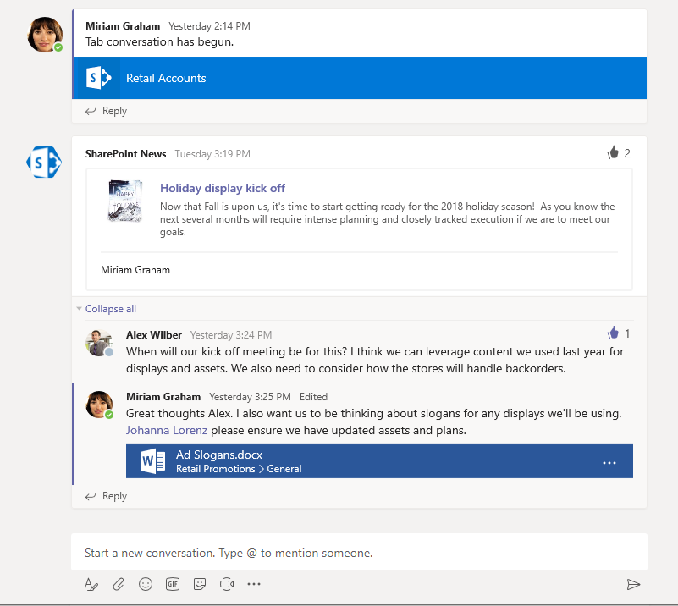
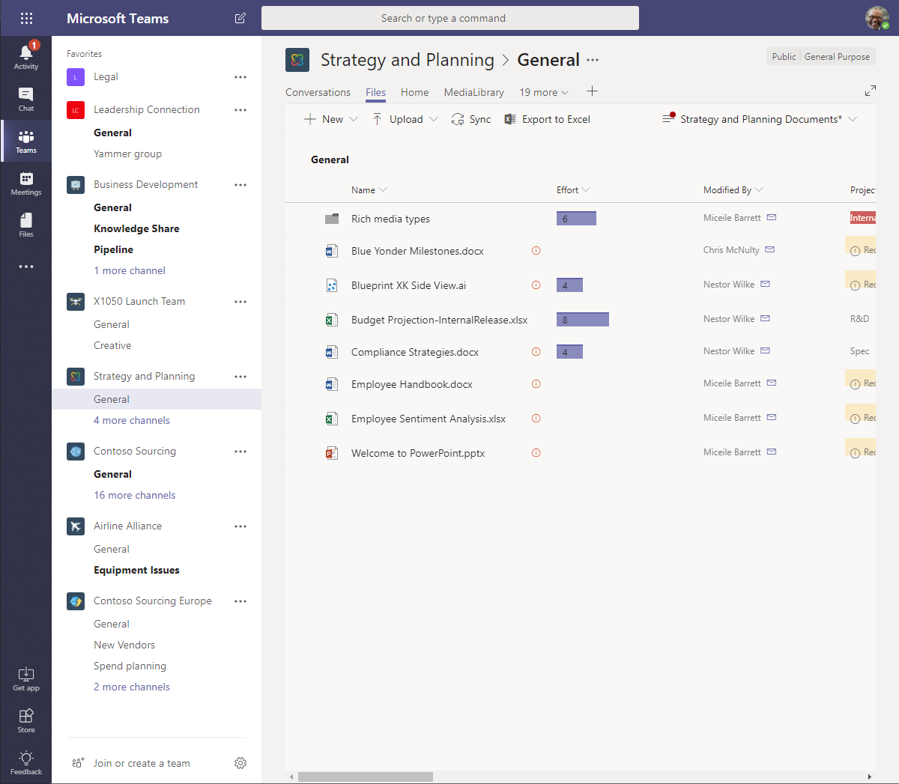
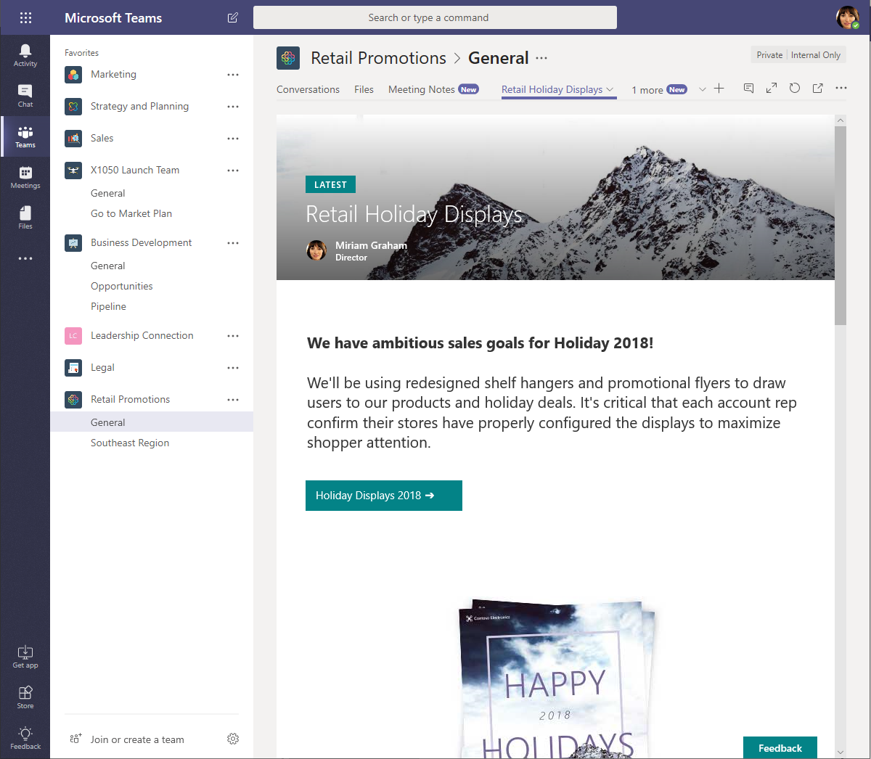
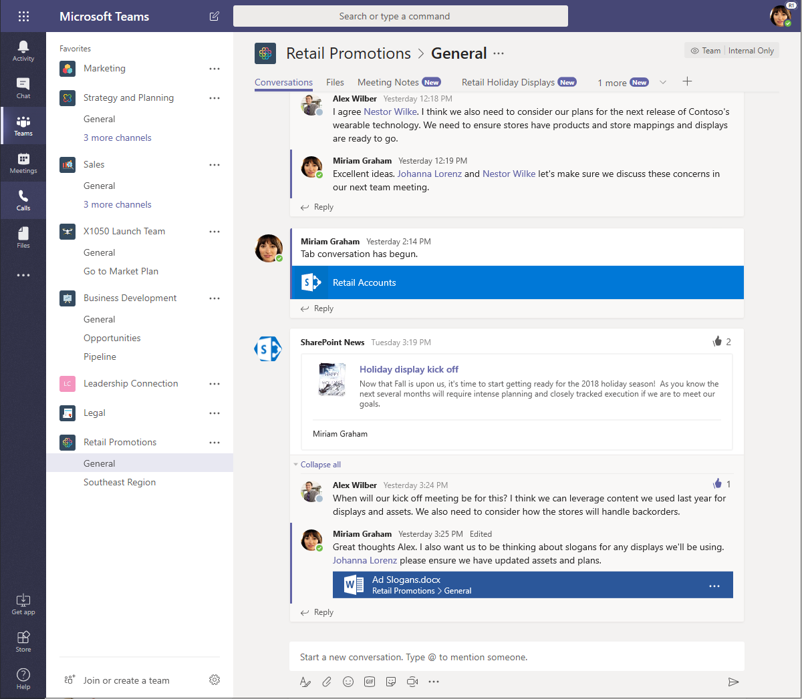
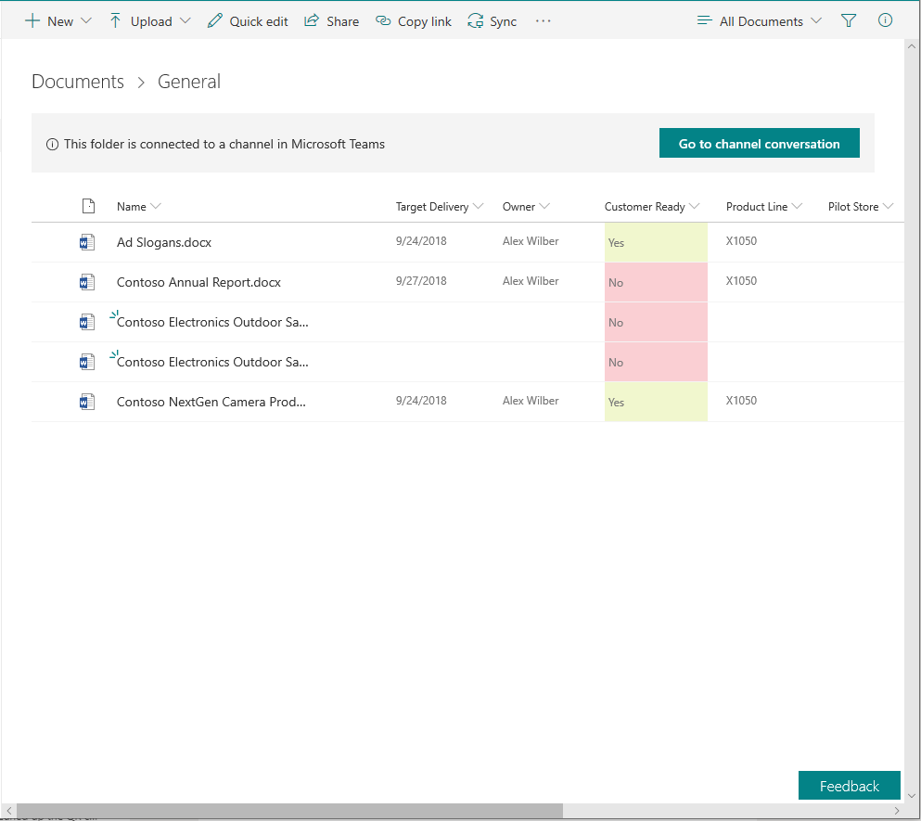
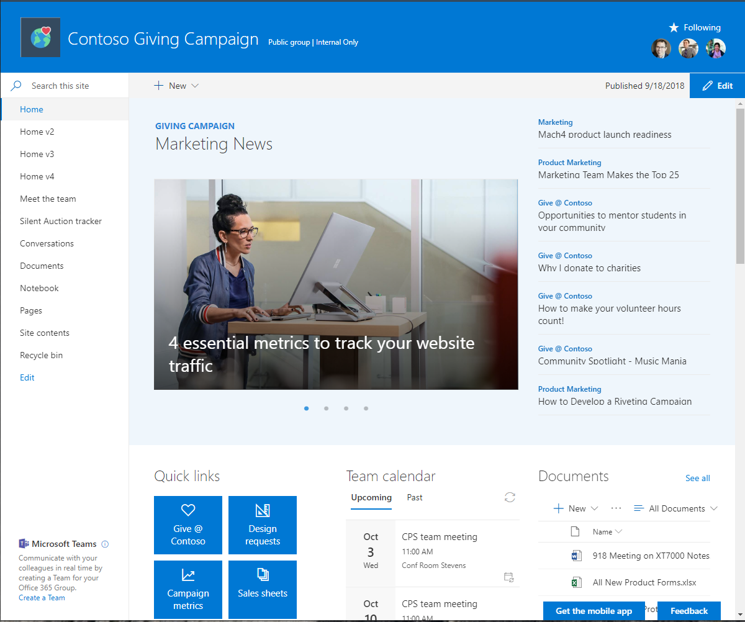
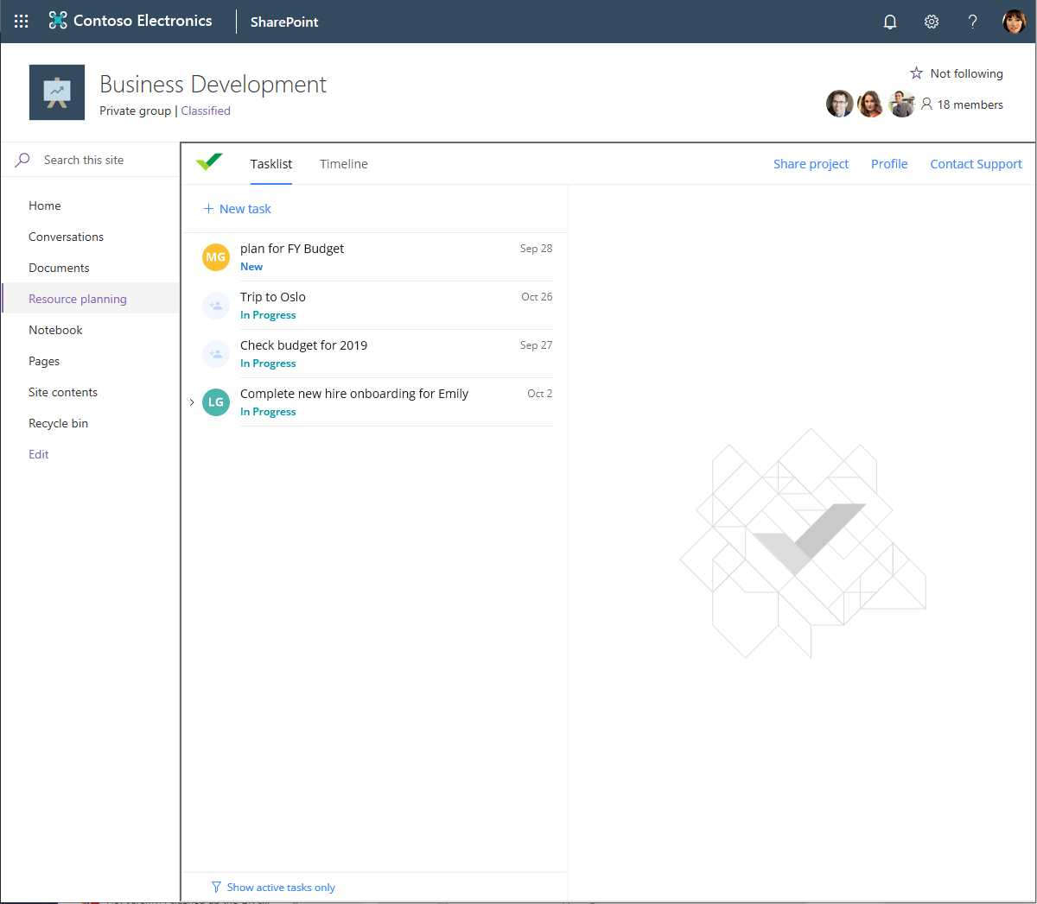
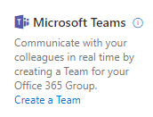
Integrated experiences
Experience SharePoint in Microsoft Teams
News
Files
Lists, pages, and apps
Experience Microsoft Teams in SharePoint
Channel folders
Add a team
Tabs as pages

Slide 7

Run Teamwork Transformation where it makes sense

Slide 8

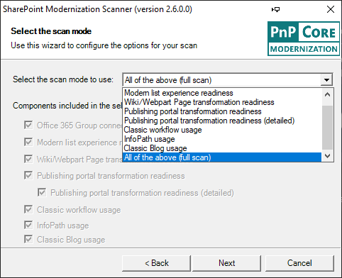
SharePoint Modernization Scanner Which sites are candidates for Teamwork Transformation?
Assessment
Download the scanner
Grab the latest version from https://aka.ms/sppnp-modernizationscanner
Prepare for scanning
Ensuring scanner permissions is crucial for a useful outcome
Run a scan
Understanding the required scanning configuration options
Reviewing the scan result
Where are the results? Did we get critical errors?
https://aka.ms/sppnp-modernizationscanner

Slide 9
SharePoint Modernization Scanner Preparing for scanning
Assessment
Ensuring scanner access
The scanner will read every site collection and as such needs to have read permissions to each site collection that needs to be scanned. Important: the scanner can also show if a site has a Teams team, this however only works using version 2.7+ and does require the Groups.Read.All application permission to be granted to the Azure AD app used for scanning.
Task: Configure Azure AD App-Only access as outlined in https://aka.ms/sppnp-modernizationscanner-azureadsetup. You’ll end with an Application ID, a certificate as PFX file and the password for that PFX file.
Task: Validate obtained Azure AD App-Only access by running a scan for a single site collection (see next slides)
Frequently Asked Questions
Question 1: I already have Azure AD App-Only setup, can I reuse that application and its certificate?
If the Azure AD application was granted the SharePoint.Read.All application permission, then it can be re-used. Ideally it also has the Groups.Read.All application permission.
Question 2: Where do I execute the scan?
A scan can take a long time to run (up to days), so ideally, it’s ran from a machine that can stay up and that’s in the same region as the SharePoint tenant. An Azure VM might be good candidate for this.

Slide 10
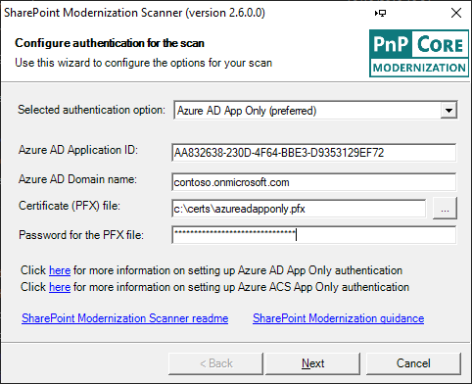
SharePoint Modernization Scanner Run a scan
Assessment
Launch the scanner
Task: Start a scan by launching the SharePoint.Modernization.Scanner.exe
Configure Authentication
Task: Choose the Azure AD App Only authentication option
Task: Fill-in the Application ID, domain name, path to the PFX file and PFX file password and press Next
Frequently Asked Questions
Question: I want to use credentials, can I?
Yes, assuming that the provided credentials have read access to the site collections that need to be scanned. Detecting of Teams teams will not work with credentials.
Question: Can I used the scanned via command-line?
Yes that’s possible. Check the scanner documentation at https://aka.ms/sppnp-modernizationscanner

Slide 11
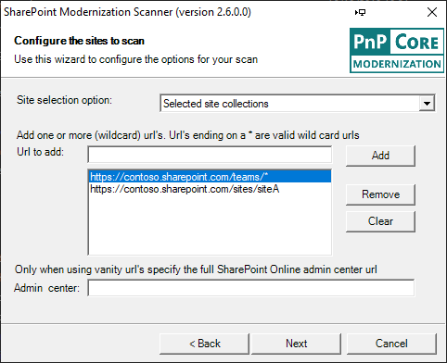
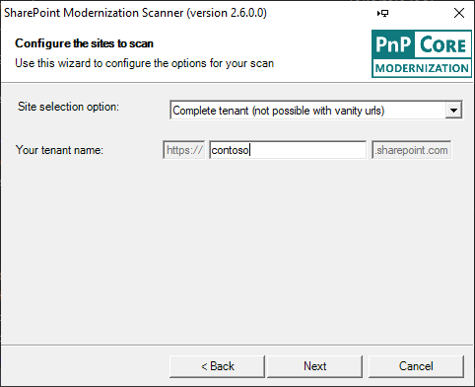
SharePoint Modernization Scanner Run a scan
Assessment
Configure the sites to scan
Task: When validating the scanner use Selected site collections and then enter the url of one or more site collections to scan and press Next
Task: For the final run use Complete tenant, enter the tenant name and press Next
Frequently Asked Questions
Question: Can I scan a specific set of site collections?
Yes, in the Selected site collections option you can use wildcards to scope the sites. Alternatively you can use the CSV file listing sites to scan option and provide a CSV file with the needed site collections. Check the scanner documentation at https://aka.ms/sppnp-modernizationscanner

Slide 12
SharePoint Modernization Scanner Run a scan
Assessment
Configure the scan mode
Task: Select the Office 365 Group connection readiness mode and press Next
Frequently Asked Questions
Question: Can I run a scan for everything?
Yes, you can via selecting the All of the above (full scan) option. However, be aware that the scan run time will be substantially longer. It’s recommended to first run the scanner with the requested Office 365 Group connection readiness option and then run a second full scan

Slide 13
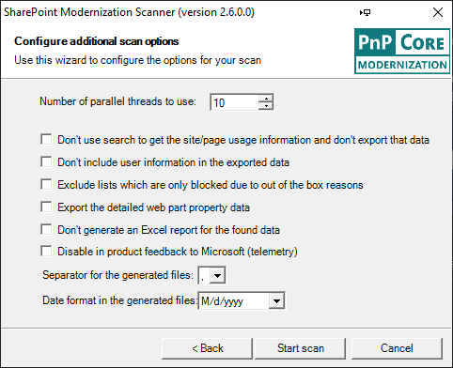
SharePoint Modernization Scanner Run a scan
Assessment
Configure the scanner options
Task: Increase the Number of parallel threads to 20 and press Start scan. The scan now starts to run
Frequently Asked Questions
Question: I’m in Europe, can I format my data accordingly?
Yes, you can opt to use semi-colon as separator for the generated CSV files + you opt to change the way how date values are written in the generated CSV files

Slide 14
SharePoint Modernization Scanner Validate scan run and collect the scan results
Assessment
Yeah, the scan ended…but was it a good one?
Task: Validate scanner output via:
Check in the scannersummary.csv file if the amount of scanned site collections is inline with your expectations
Check if the created CSV files contain relevant data
Check the created error.csv and review the errors
The scan results need to be analyzed. If needed copy them to the computer used for analysis work
Task: Navigate to the folder holding the scanner executable. Each scan run creates a folder (=timestamp). Locate the folder from the scanner run you need, zip the complete folder and copy
Frequently Asked Questions
Question: I see entries in error.csv…is this bad?
It depends, large scans will always have some errors. If you see large quantities of errors than something is wrong, typically these are access denied errors because the used credentials/app-only principal are not having the required permissions

Slide 15

Designing for execution

Slide 16

SharePoint and Teams better together What is the impact of the Teamwork Transformation on my sites
Strategy
Classic SharePoint Site
Lists
Libraries
Custom code
Classic Pages
Custom branding
Owners
Members
Visitors
Admins
The classic SharePoint sites you’re transforming today contain:
Lists and Libraries: Each site has multiple lists and libraries. Typically these are presented using a modern UI, although there can be certain lists and libraries that are still showing using the classic UI.
Classic pages: Classic sites mainly have wiki pages but also web part pages are commonly used
Custom branding: Sites can have a custom theme, even custom master pages and alternate CSS settings
Custom code: Custom code can be present. Redesigning custom code is out of scope for this program, but https://docs.microsoft.com/en-us/sharepoint/dev/transform/modernize-customizations can get you started
Access: Typically users get access to the site by being member of out of the box groups like Owners, Members,…

Slide 17
SharePoint and Teams better together What is the impact of the Teamwork Transformation on my sites
Strategy
Classic SharePoint Site
Modernized SharePoint Site
Lists
Libraries
Custom code
Modern lists and libraries
SPFX custom code
Classic Pages
Custom branding
Modern + classic pages
Tenant theme applied
Owners
Members
Visitors
Admins
Owners
Members
Visitors
Admins
Your work will result in a modernized SharePoint site
Lists and Libraries: Lists and libraries are for the most part already showing using the modern UI and when a list can’t be shown using modern SharePoint will automatically switch back the classic list UI. During modernization you’ll remove possible modernization blockers:
Script: A site can be ‘forced’ to be a classic site at either site collection or web scope, the modernization script will fix this by turning off the site/web scoped blocks
Script: A list/library can be ‘forced’ to be shown in classic UI, the modernization script will fix this by setting the library back to the default ‘automatic’ state
Optional: there can be more fine-grained reasons: see https://docs.microsoft.com/en-us/sharepoint/dev/transform/modernize-userinterface-lists-and-libraries for more details if required

Slide 18
SharePoint and Teams better together What is the impact of the Teamwork Transformation on my sites
Strategy
Classic SharePoint Site
Modernized SharePoint Site
Lists
Libraries
Custom code
Modern lists and libraries
SPFX custom code
Classic Pages
Custom branding
Modern + classic pages
Tenant theme applied
Owners
Members
Visitors
Admins
Owners
Members
Visitors
Admins
Your work will result in a modernized SharePoint site
Modern + classic pages: The wiki and web part pages in a SharePoint site will not automatically display as modern pages. In contrast with lists and libraries SharePoint can’t simply show a classic page as modern because the page models are too different. This will result in a continues switching between classic and modern UI when users navigate in the site.
Script: The modernization script will use the open source page transformation framework to create modern versions of the existing classic pages. During this process, the newly created modern pages will take the name of the classic pages while the classic pages are renamed to previous_. No classic pages will be deleted, and you can make the classic page the default again via renaming it. Learn more about page transformation via https://aka.ms/sppnp-pagetransformation.

Slide 19
SharePoint and Teams better together What is the impact of the Teamwork Transformation on my sites
Strategy
Classic SharePoint Site
Modernized SharePoint Site
Lists
Libraries
Custom code
Modern lists and libraries
SPFX custom code
Classic Pages
Custom branding
Modern + classic pages
Tenant theme applied
Owners
Members
Visitors
Admins
Owners
Members
Visitors
Admins
Your work will result in a modernized SharePoint site
Tenant theme: The classic SharePoint site can use a custom theme to show the company brand and it might also be using a custom master page or alternate CSS to further customize the branding of the site. Classic themes are hard to manage and using a modern tenant-controlled theme is much better. Modern UI does not use custom master page definitions or alternate CSS anymore, modern pages are responsive by design and work great on any device.
Script: The modernization script will allow you to set a pre-defined modern tenant theme + it will switch back to the default master page and alternate CSS settings. You can learn more via https://docs.microsoft.com/en-us/sharepoint/dev/transform/modernize-branding.

Slide 20
SharePoint and Teams better together What is the impact of the Teamwork Transformation on my sites
Strategy design
Classic SharePoint Site
Modernized SharePoint Site
Office 365 group in Azure AD
Lists
Libraries
Custom code
Modern lists and libraries
SPFX custom code
Owners
Members
Classic Pages
Custom branding
Modern + classic pages
Tenant theme applied
Owners
Members
Visitors
Admins
Owners
Members
Visitors
Admins
Your work will result in a modernized SharePoint site
Office 365 Group connection: A site collection needs to be connected with an Office 365 Group before this site collection can use or be used by other group connected services like Microsoft Teams, Yammer, Planner, … A common question is about sub sites: there’s only one Office 365 Group per site collection, see https://docs.microsoft.com/en-us/sharepoint/dev/transform/modernize-connect-to-office365-group-subsites for the sub site impact.
Script: The script will perform the Office 365 Group connection. This will trigger the creation of a new Office 365 group which will be connected to SharePoint site. Existing Office 365 Groups cannot be connected to a SharePoint site because each Office 365 Group already has a SharePoint site connected
Script: The group connection process will create a new standard modern home page. Optionally the script can be configured to keep using the modernized classic home page.

Slide 21
SharePoint and Teams better together What is the impact of the Teamwork Transformation on my sites
Strategy
Classic SharePoint Site
Modernized SharePoint Site
Office 365 group in Azure AD
Lists
Libraries
Custom code
Modern lists and libraries
SPFX custom code
Owners
Members
Classic Pages
Custom branding
Modern + classic pages
Tenant theme applied
Owners
Members
Visitors
Admins
Owners
Members
Visitors
Admins
Your work will result in a modernized SharePoint site
Office 365 Group security impact: After Office 365 Group connection the default setup will be that Office 365 Group owners will be part of the site’s Owners SharePoint group and the site collection administrators group. Group owners as such will be able to see all site collection content. The Office 365 Group members will be part of the site’s Members SharePoint group. By default the Office 365 Group owners will contain the account running the Office 365 group connect. See https://docs.microsoft.com/en-us/sharepoint/dev/transform/modernize-connect-to-office365-group-permissions to learn more.
Script: The script will, besides running the Office 365 Group connect, also copy over the user accounts from the current SharePoint site administrators and owners to the Office 365 Group owners and the current SharePoint site members to the Office 365 Group members.

Slide 22
SharePoint and Teams better together What is the impact of the Teamwork Transformation on my sites
Strategy
Classic SharePoint Site
Modernized SharePoint Site
Office 365 group in Azure AD
Lists
Libraries
Custom code
Modern lists and libraries
SPFX custom code
Owners
Members
Classic Pages
Custom branding
Modern + classic pages
Tenant theme applied
Owners
Members
Visitors
Admins
Owners
Members
Visitors
Admins
Teams team
Your work will result in a modernized SharePoint site
Provision a Teams team: A key reason to group connected a site is using that existing site linked to Microsoft Teams. A Microsoft Teams team is a collaboration hub that unites team related work. After you’ve connected a Microsoft Teams team (“teamify”) you have a Teams team that has a “General” channel which uses the SharePoint site’s default document library to store documents.
Script: You can manually do the “teamify” step from the SharePoint UI, but this can also be handled by the modernization script
Optional: Optionally you can apply a PnP Tenant template that allows you to further pre-populate the Teams team by adding additional channels, by adding messages in the chat, by adding SharePoint modern pages as tabs or by adding additional SharePoint lists and libraries as tab.
Channels
Chat
Files
Pages
Lists/Libraries

Slide 23
Office 365 Group naming strategy How will you name the Office 365 Groups?
Strategy
The Office 365 Group names you’ll be using during the Office 365 Group Connect step will have to be unique across your Azure AD environment. Therefore it’s important that you think about a group naming convention.
Task: Define a group naming convention that you can apply to the sites that will be modernized
Task: Consider configuring Office 365 Group naming policies in Azure AD to help enforce group naming. See https://docs.microsoft.com/en-ca/azure/active-directory/users-groups-roles/groups-naming-policy and https://docs.microsoft.com/en-us/office365/admin/create-groups/groups-naming-policy?redirectSourcePath=%252fen-us%252farticle%252foffice-365-groups-naming-policy-6ceca4d3-cad1-4532-9f0f-d469dfbbb552&view=o365-worldwide to learn more.
Frequently Asked Questions
Question: How can verify that the groups I propose are valid?
Check the execution step of this guide, group name (=alias) verification is part of the modernization scripts

Slide 24
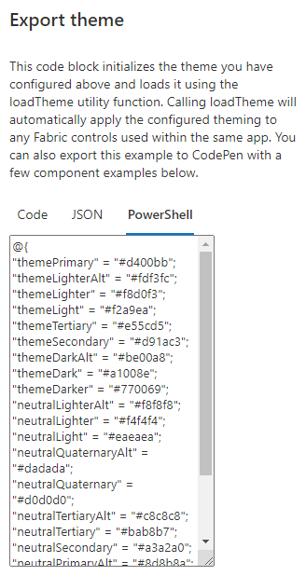
Office 365 Tenant themes How to setup tenant themes?
Strategy
During the Teamwork Transformation you’ll be (optionally) setting the site’s theme to a tenant theme. For this to work you’ll need to first ensure the needed tenant themes are available
Task: Create the needed tenant themes. Use the online theme generator (https://aka.ms/themedesigner) to create the themes, use the Export theme option and copy the PowerShell formatting
Task: Add the new theme to the tenant via
Assigning the copied PowerShell to a variable: $ContosoTheme = @{“themePrimary”=…
Adding the theme: Add-PnPTenantTheme -Palette $ContosoTheme -Identity “Contoso Corporate theme" -IsInverted:$false
See https://docs.microsoft.com/en-us/powershell/module/sharepoint-pnp/add-pnptenanttheme?view=sharepoint-ps for more details
Frequently Asked Questions
Question: How can I get a list of available tenant themes using PnP PowerShell?
You can use the Get-PnPTenantTheme cmdlet to get a list of available tenant themes

Slide 25
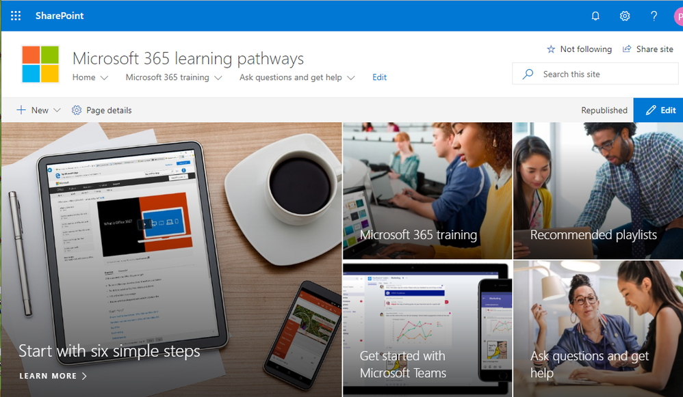
Training your end-users for Microsoft Teams How can I ensure my end-users are ready for the changed experience?
Strategy
Microsoft 365 learning pathways is a customizable, on-demand training solution designed to increase usage and adoption for all of Microsoft 365 in your organization
Task: Deploy this solution inside your organization and configure it to your needs. See https://techcommunity.microsoft.com/t5/Driving-Adoption-Blog/Microsoft-announces-general-availability-for-Microsoft-365/ba-p/978440 for more details.

Slide 26

Let’s start to modernize!

Slide 27

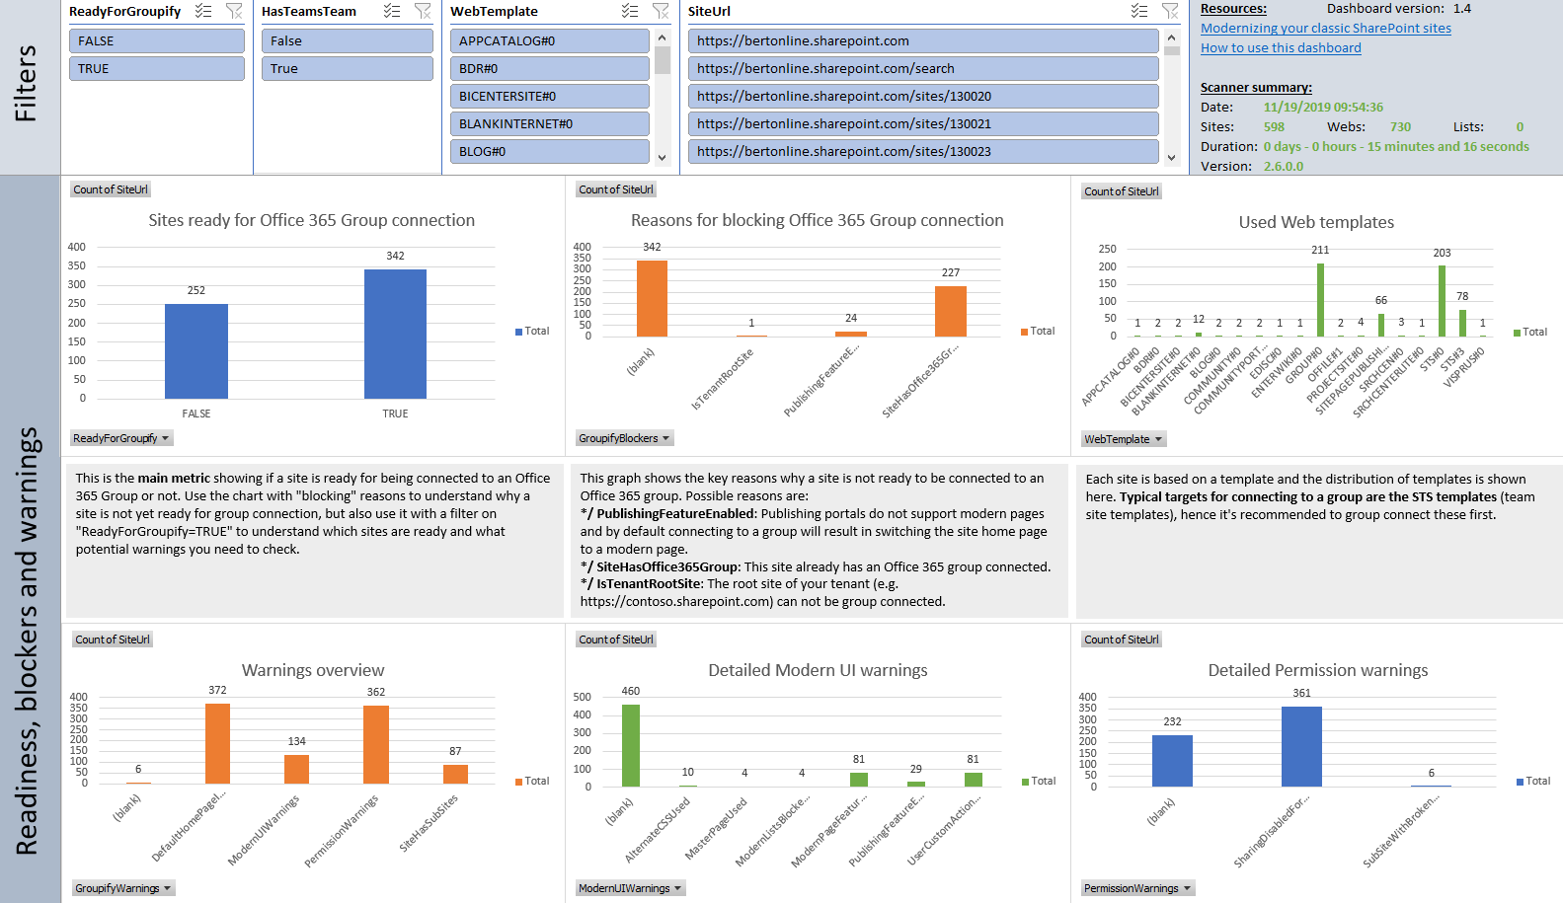
Identify sites for Teamwork Transformation Processing the scan results
Execution
The scan results will help you identify site collections which are good candidates for Teamwork Transformation
The Office 365 Group connect reports will contain information about all the scanned site collections, so a filtering is needed to identify the sites that are Teamwork Transformation candidates
Once there’s a list of sites for Teamwork Transformation the next step is splitting them up in waves. The recommended approach is to start with a pilot wave that runs Teamwork Transformation on a relatively small amount of sites. Goal is to gather customer feedback and finetune the modernization script if needed
Depending on the amount of sites and the input from the customer the remaining sites are handled in a series of additional waves
See https://docs.microsoft.com/en-us/sharepoint/dev/transform/modernize-scanner-reports-groupconnect to learn more about the Office 365 Group connect reports
Office 365 Group Connection Readiness.xlsx
All sites
Teamwork Transformation sites
Pilot
Wave 1
Wave 2

Slide 28
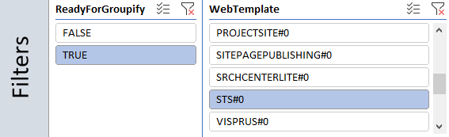
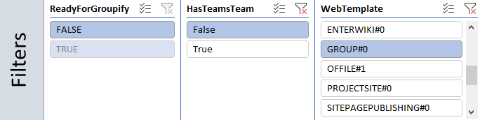
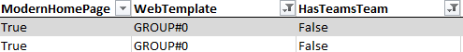
Identify sites for Teamwork Transformation Processing the scan results
Execution
Filtering the Office 365 Group connect (= “groupify”) report to identify sites for Teamwork Transformation
Task: copy the Office 365 Group connect report files to the computer used for analysis:
Office 365 Group Connection Readiness.xlsx
ModernizationSiteScanResults.csv
ModernizationWebScanResults.csv
ModernizationUserCustomActionScanResults.csv
Task: Right click the Dashboard sheet and unhide the ReadyForGroupify sheet
Task: Applying “ReadyForGroupify = TRUE” and “WebTemplate = STS#0” does give you a good starting point as these are team sites without an Office 365 Group connect blocker.
Task: Applying “WebTemplate = GROUP#0” and “HasTeamsTeam = FALSE” does give you the modern team sites that do not yet have a Teams team
Dashboard sheet
ReadyForGroupify sheet or modernsitescanresults.csv
Dashboard sheet
ReadyForGroupify sheet or modernsitescanresults.csv

Slide 29
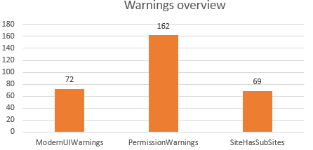
Identify sites for Teamwork Transformation Processing the scan results
Execution
What about the SiteHasSubSites warnings?
If a site collection has sub sites, then this warning will be shown.
Task: If the sub sites map to individual teams in the organization it makes sense to move those sub sites into their own (modern, group connected) site collections, in all other cases the recommendation is to group connect the site collections and run modernization for the sub sites.
Frequently Asked Questions
Question: Can I have an Office 365 Group for a sub site?
No, this is not possible. There can only be one Office 365 Group per site collection
Question: Can sub sites still use Office 365 Group connected services?
Yes, depending on the Office 365 Group connected service, there options to use the service at sub site level. See https://docs.microsoft.com/en-us/sharepoint/dev/transform/modernize-connect-to-office365-group-subsites to learn more.
Question: Can I automatically convert the sub sites in individual site collections?
No, there is not native SharePoint feature to do this. You can however use migration tools to copy over the sub site contents into a newly created modern site collection. You can use page transformation to modernize the wiki and web part pages in that sub site
Dashboard sheet

Slide 30
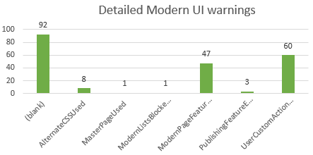
Identify sites for Teamwork Transformation Processing the scan results
Execution
What about the ModernUI warnings?
These warnings are triggered if there are settings on the site that prevent optimal use of the modern SharePoint UI. Of the 6 possible warnings 4 can be fixed by the modernization script:
AlternateCSS and MasterPage impact the branding of classic pages and can be reset to their default values
ModernListsBlocked due blocking at site, web or list level will be undone
ModernPagesBlocked due to blocking at web level will be undone
Task: Review the sites with publishingFeature enabled: if there are also custom publishing pages used then the site should not be group connected, if not assess if the publishing features can be disabled
Task: If there are usercustomactions then review these, quite often these are not relevant anymore. If still relevant consider building an SPFX based equivalent and deploy that as part of the modernization script.
Dashboard sheet
Dashboard sheet

Slide 31
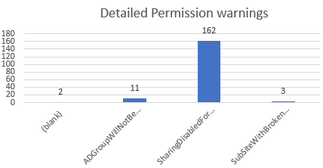
Identify sites for Teamwork Transformation Processing the scan results
Execution
What about the Permission warnings?
Sites with a security setting that might be impacted by the security changes created by the Office 365 Group connect are listed here. The modernization script will not address any of these warnings.
Task: Sites with the ADGroupWillNotBeExpanded warning do have AD groups in their default SharePoint groups and since the Office 365 Group owners and members can’t contain other groups these are not copied over. Quite often the groups are used to give a large people read-only access to the SharePoint site and that’s fine. If it’s important that the people in the AD group also have access to the other Office 365 Group connected services, then these people have to be added individually to the Office 365 Group owners and members
Task: SharingDisabled implies that the SharePoint site is not shared with external users while the Office 365 Group can be. The SharePoint settings are not overridden by the Office 365 Group settings, so this should be fine. See https://docs.microsoft.com/en-us/sharepoint/dev/transform/modernize-connect-to-office365-group-externalsharing to learn more.
Task: Review the sites that have SubSitesWithBrokenPermissions: since group owners are also site collection administrators, they also will be able to see all SharePoint objects (sites, libraries, items) with specific permissions. If this is not desired, then it’s recommended to move the impacted subsites to their own modern group connected site collection
Dashboard sheet
Dashboard sheet

Slide 32
Build the Teamwork Transformation waves Group the selected site collections in transformation waves
Execution
The actual transformation work should be done in waves
A waved approach allows you to start small followed by gathering feedback and if needed adjusting the approach for the next wave. After each transformation wave this feedback and adjustment step should be taken
Task: Split the list of site collections you’ve gathered in waves:
One or more pilot waves: these are small waves, typically with sites from IT savvy users or from the folks in the organization that live to embrace change
The following “production” waves can be organized in various ways: by department, by country, by complexity, …
The time it will take of modernize a site collection in seconds is approximately 120 + (15 seconds * number of classic pages)
Frequently Asked Questions
Question: How big should I make the waves?
There is not formal number and wave sizes can be different based upon the chosen wave organization. The recommendation is to start with relatively small waves.
Pilot 1
Feedback
Pilot 2
Feedback
Wave 1
Feedback
Wave 2
Feedback
Wave n

Slide 33
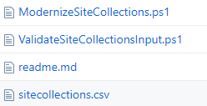
Build the Teamwork Transformation script Get the latest scripts and tailor them to your needs
Execution
Navigate to https://aka.ms/sppnp-modernization-sitecollectionscripts to get the latest scripts
Important: These scripts require the December 2019 (3.16.1912.*) release of PnP Powershell
Task: Copy the ModernizeSiteCollections.ps1, ValidateSiteCollectionsInput.ps1 and sitecollections.csv file to your machine
Task: Review the ModernizeSite function in the ModernizeSiteCollections.ps1 script:
Most steps of the script are controlled via the input you provide but you can optionally remove some steps (e.g. resetting master pages and alternate css) if that’s better for your customer
You can add additional steps (e.g. deploying and configuring SPFX based customizations)
Task: Test the ModernizeSiteCollections.ps1 script by running it and providing a single site collection to modernize
Frequently Asked Questions
Question: I’ve found a bug in the scripts or I have a cool addition I want to share. Where do I go?
Create an issue in https://github.com/SharePoint/sp-dev-modernization/issues for bugs/questions. For changes you can also submit a PR to this GitHub repository

Slide 34
Build the Teamwork Transformation input Create the CSV file to drive the Teamwork Transformation
Execution
The modernization scripts take a CSV file as input. This CSV drives the script’s actions and this for a set of site collections
Task: Prepare CSV files for your transformation needs. You can have multiple CSV files per transformation wave. The CSV needs to contain these columns:
SiteUrl: the url of the site collection
O365GroupAlias: the alias for the Office 365 Group
AddTeamTeam: true to create a Teams team (if not yet available) for the Office 365 group linked to this site collection
ModernizePages: modernizes the classic pages in the site to become modern pages. The classic pages are not deleted but renamed and are still available in the SitePages library
ModernizeBranding: cleans the old branding settings (master pages, alternate css)
TenantTheme: if set this tenant theme will be configured for the site collection
Classification: if set this value will be set as site classification (see https://docs.microsoft.com/en-us/office365/enterprise/powershell/manage-office-365-groups-with-powershell)
Frequently Asked Questions
Question: Can I have ?
No, this

Slide 35
Validate the Teamwork Transformation input Run a validation on the CSV files used to drive the Teamwork Transformation
Execution
Before running the Teamwork Transformation it’s important to validate the input (alias must be valid and unique, theme needs to exist, classification must be available)
Task: Run the ValidateSiteCollectionsInput.ps1 and provide your CSV file as input. Check the console and log outputs to understand what errors were found
Frequently Asked Questions
Question: Where can I learn more about the validation details?
Office 365 Group naming policy: https://docs.microsoft.com/en-us/office365/admin/create-groups/groups-naming-policy?redirectSourcePath=%252fen-us%252farticle%252foffice-365-groups-naming-policy-6ceca4d3-cad1-4532-9f0f-d469dfbbb552&view=o365-worldwide
Who can create Groups: https://docs.microsoft.com/en-us/office365/admin/create-groups/manage-creation-of-groups?redirectSourcePath=%252fen-us%252farticle%252fmanage-who-can-create-office-365-groups-4c46c8cb-17d0-44b5-9776-005fced8e618&view=o365-worldwide
Group classifications: https://docs.microsoft.com/en-us/office365/enterprise/powershell/manage-office-365-groups-with-powershell
Tenant themes: https://docs.microsoft.com/en-us/powershell/module/sharepoint-pnp/add-pnptenanttheme?view=sharepoint-ps

Slide 36
Run the Teamwork Transformation script Modernize a wave of site collections
Execution
Yes, you’re ready to run Teamwork Transformation for your site collections!
Task: Run the ModernizeSiteCollections.ps1 script and provide it your prepared site collection CSV file and the other information in needs
Task: Review the created logs (there are the modernization log files and the page transformation log file) for issues
Frequently Asked Questions
Question: Can I run the script without being prompted for credentials?
Yes, you can define the credentials (via credential manager) in your script

Slide 37

Getting help
What’s next ideas

Slide 38

Getting help What resources can I tap into?
Support
For questions on this deck and on the used scripts the best place to get help is the issue list in the sp-dev-modernization GitHub repository: https://github.com/SharePoint/sp-dev-modernization/issues
You’ve added a cool extension, fixed a type, fixed a bug…any contribution to the existing content that you can share back will help the SharePoint community.
Sharing can be done by creating a Pull Request against the dev branch of the https://github.com/SharePoint/sp-dev-modernization repository
If you’re unfamiliar with Git you can also describe the change in the issue list

Slide 39
What’s next? What else can you consider combining with the Teamwork Transformation?
Support
Make the Teams experience richer by populating the created Teams team with channels and messages. See https://docs.microsoft.com/en-us/sharepoint/dev/solution-guidance/pnp-provisioning-tenant-templates on how to get started with PnP Tenant templates that provision Teams content
Create SharePoint Framework based customizations to replace existing, business critical, classic customizations. The customizations can also be hosted in Teams. See https://docs.microsoft.com/en-us/sharepoint/dev/spfx/sharepoint-framework-overview to learn more.

Slide 40


Resources
Modernization home: https://aka.ms/sppnp-modernize
Page transformation home: https://aka.ms/sppnp-pagetransformation
Page transformation videos: https://aka.ms/sppnp-pagetransformationvideos
Modernization scanner: https://aka.ms/sppnp-modernizationscanner
PnP Provisioning Portal: https://provisioning.sharepointpnp.com
Look Book: https://lookbook.microsoft.com

Slide 41


